Slide 1
Introduction to Machine Learning
DATA MAX

Slide 2
What is Machine Learning (ML)?
Goal
Machines that learn to perform a task from experience
Why?
Task cannot be well defined
Volume is too big to analyze
Environment changes
New knowledge becomes available

Slide 3
ML: Learning
Learning to perform a task from experience
Learning
Most important!
We don’t want to encode knowledge
Machine should discover and learn relevant criteria automatically from past observations
Tools
Statistics
Probability Theory
Decision Theory
Information Theory
Optimization Theory

Slide 4
ML: Task
Learning to perform a task from experience
Task
Usually a function
y = f(x,w)
x: input aka. features
y: output aka. target
w: parameters
Classification vs. Regression
Classification: discrete y
Regression: continuous y

Slide 5
Classification
Examples:
Character recognition (OCR)
Email filtering
Image classification

Slide 6
Regression
Examples:
Forecasting of the price
Evaluation of an asset (house, car, plot of land)
Prediction of sales for a product

Slide 7
ML: Perform
Performance
“99% correct classification”
Of what??
What training/testing data set?
Is it matching reality?
Performance Measure:
Typicaly a number
Different for classification vs. regression

Slide 8
ML: Experience
Experience
When labeled data available:
Supervised learning
No labeled data available
Unsupervised learning
Some labeled data available
Semi-supervised learning
Feedback/rewards
Reinforcement learning

Slide 9
Basic Algorithms
Linear Regression
Logistic Regression
SVM
Decision Tree (Forest)
Naïve Bayes
K-Means Clustering
DBSCAN Clustering

Slide 10
Linear Regression

Slide 11
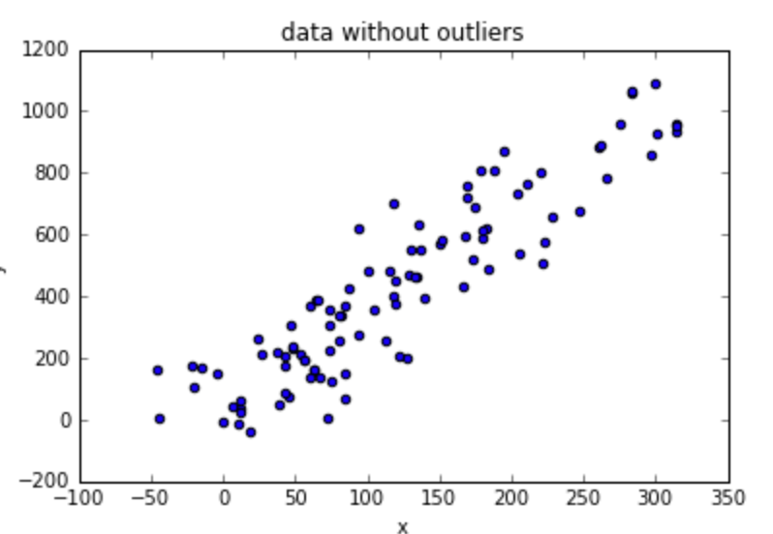
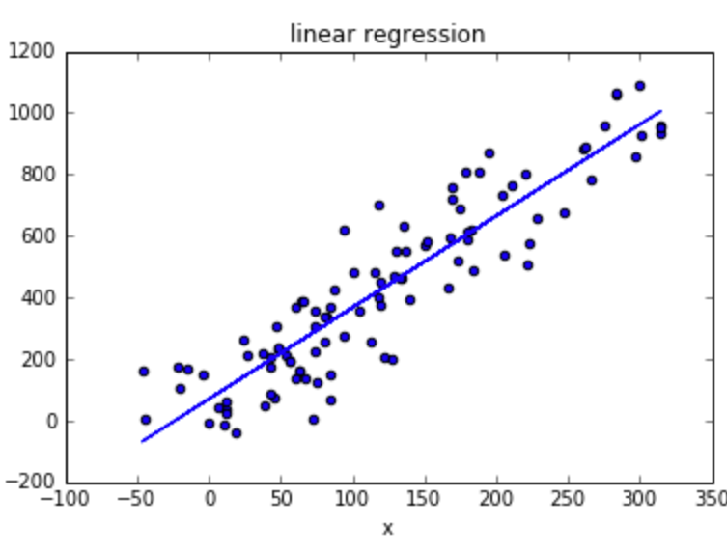
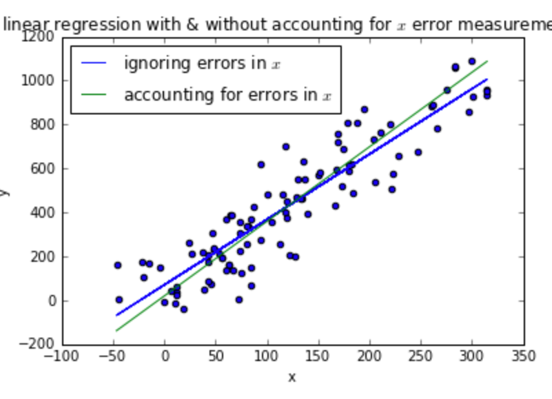
Linear Regression
Relationship between target and features
Find a line that best fits the data

Slide 12
Linear Regression
y = wx + w₀
y -> target
x -> feature
w -> weight
y = f(x₁, x₂, x₃, x₄ ,…, x_{n})
y_{k} = w₁x_{1k} +w₂x_{2k} + w₃x_{3k} + w₄x_{4k} +…+ w_{n}x_{nk} + w₀

Slide 13
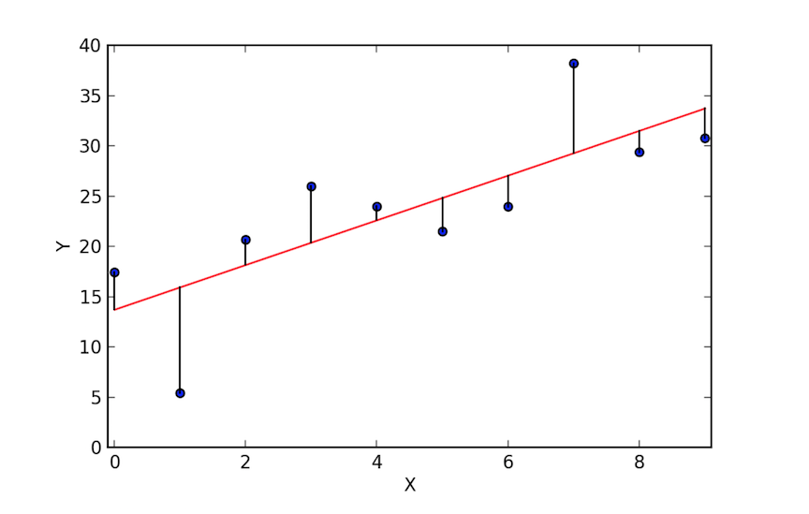
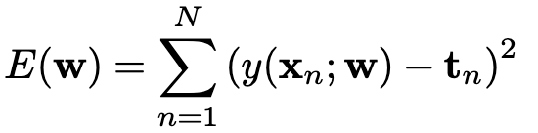
Linear Regression
Goal: Reduce residuals (loss)
Least square method
Try to minimize the sum-of-squares error
LS

Slide 14
Hands-on Time 🎉

Slide 15
Programming Language HTTP libraries.
Python: FastAPI, Flask, Django
Golang: net/http, gorilla/mux
Nodejs: ExpressJS
Java: Spring Boot, Micronaut

Slide 16
Restful Web Services
Resource
Endpoint
Request Method

Slide 17
JSON over HTTP
POST /api/login HTTP/1.1
Content-Type: application/json
{
"username": "admin",
"password": "admin"
}
HTTP/1.1 200 OK
Content-Type: application/json
{
"access_token": "Axd0amasjbai901iu2bieuq==",
"refresh_token": "Aisndoaisnd1iu2983asd="
}

Slide 18
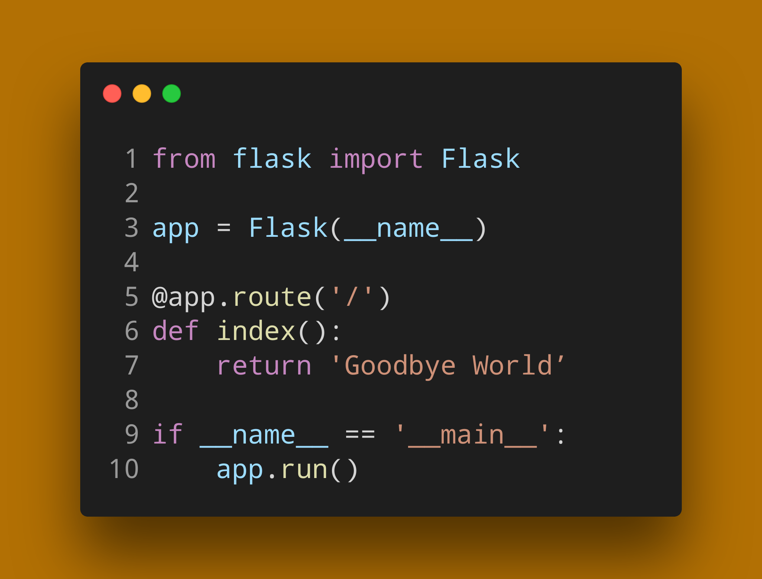
Python Flask Http server

Slide 19
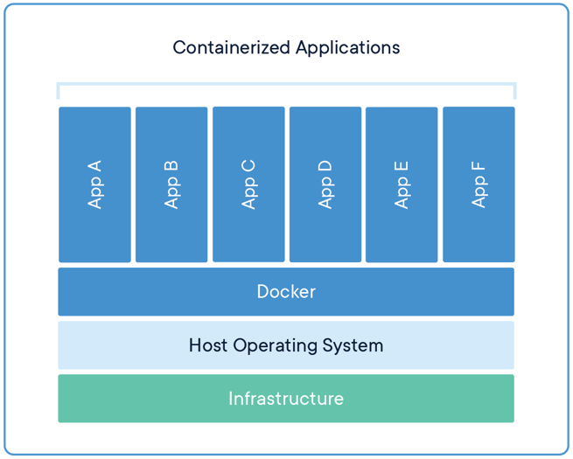
Docker Container Engine
Docker Images:
Lightweight standalone, executable package of software.
Includes everything needed to run an application.
Docker images become containers at runtime.
Docker Containers:
Isolate software from its environment.
Isolates containers from each-other.
Ensure that it works uniformly in every environment and machine.
No more: "IT RUNS ON MY MACHINE, YOURS IS BROKEN"

Slide 20
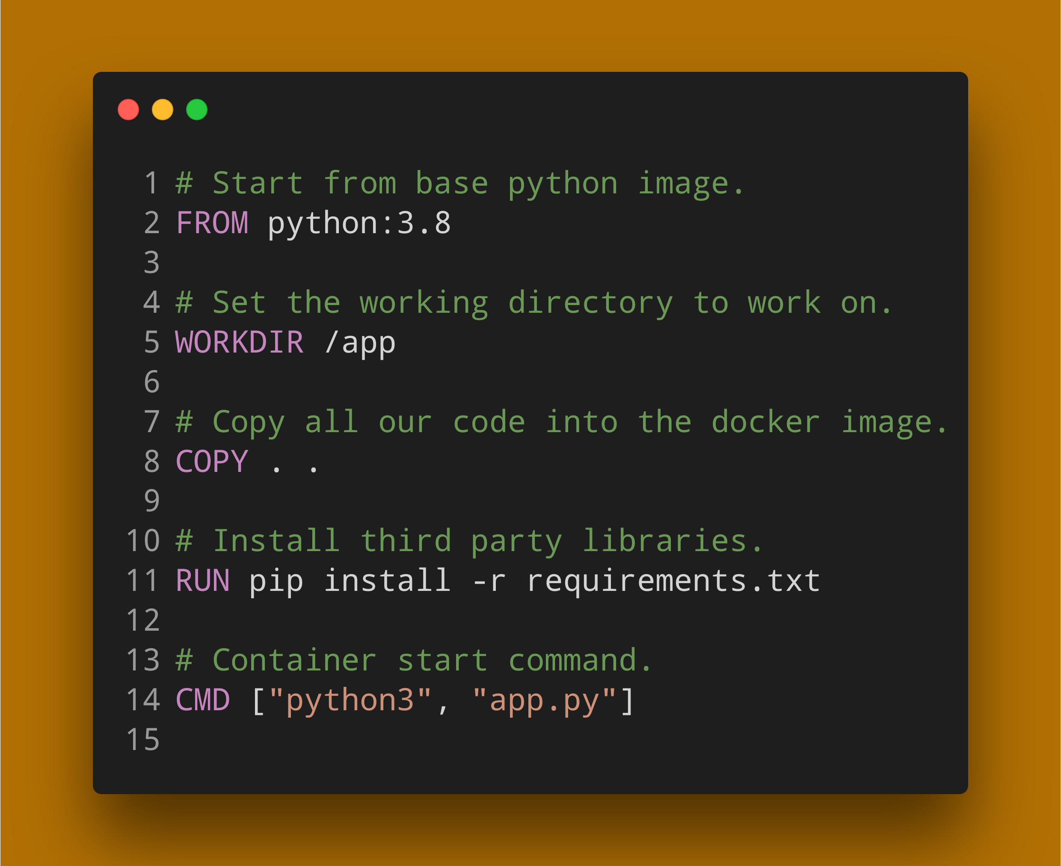
Dockerfile for our HTTP Server

Slide 21
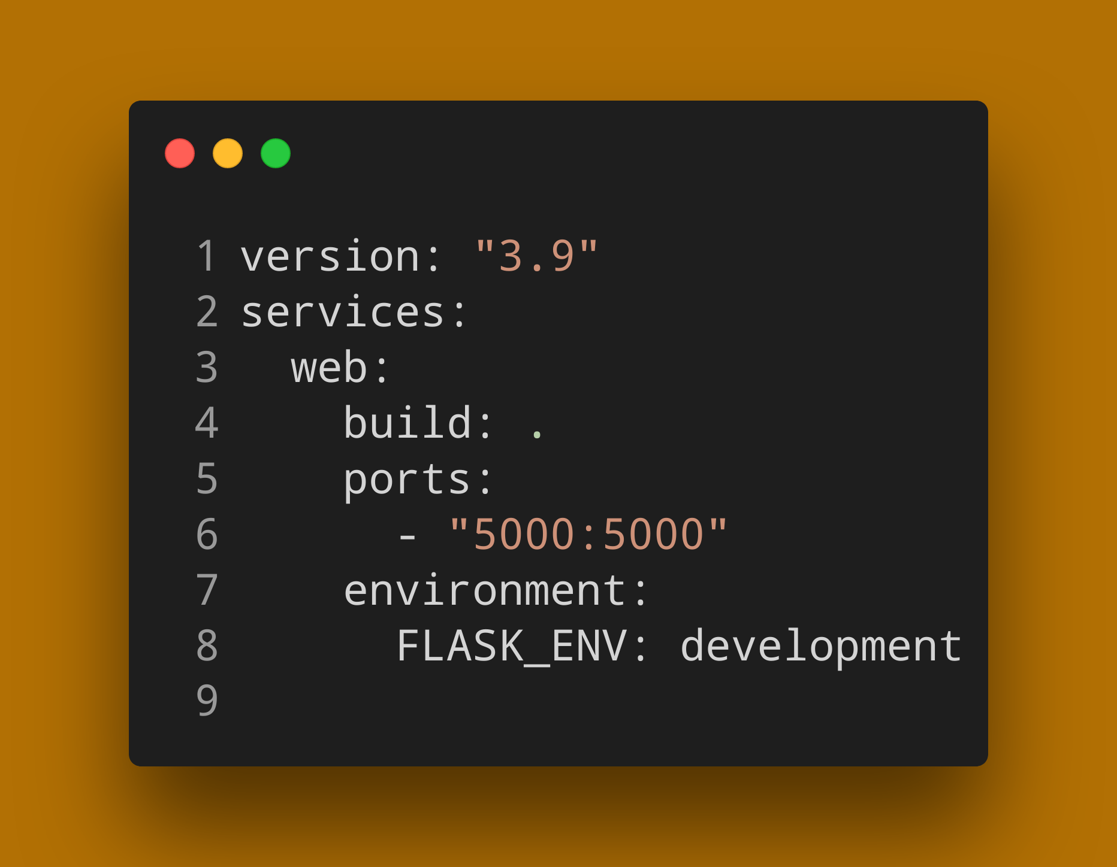
Example Docker Compose File

Slide 22
More Hands-on Time 🎉

